Slide 1
HUSCＡP:
Hokkaido University collection of SCholarly and Academic Papers
2015.1.28
Hokkaido University Library
Kenichi TOMITA

Slide 2
Hokkaido University
Open Access in Hokkaido University
・ Founded 1876
・ National University
・ Sapporo, JAPAN （Main campus)
・ 20 graduate schools and faculties and
27 research institutes and centers
  2,057 academic staff
  6,195 graduate students
  11,649 undergraduates
・ 2,500-3,000 papers a year
(Web of Science)
・

Slide 3
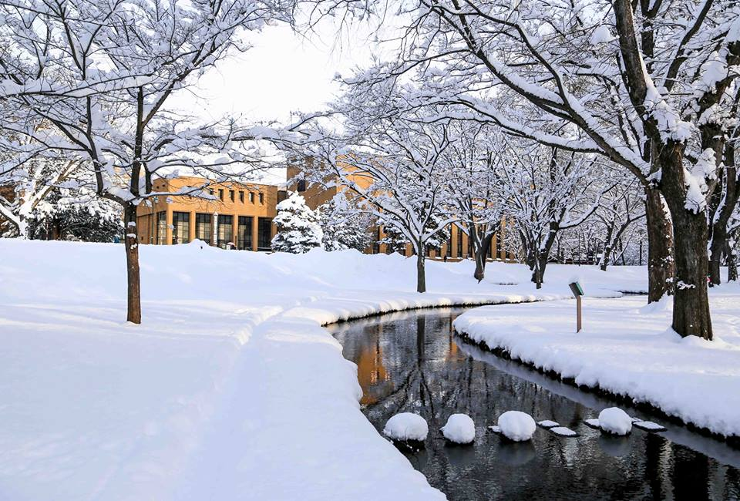

Slide 4
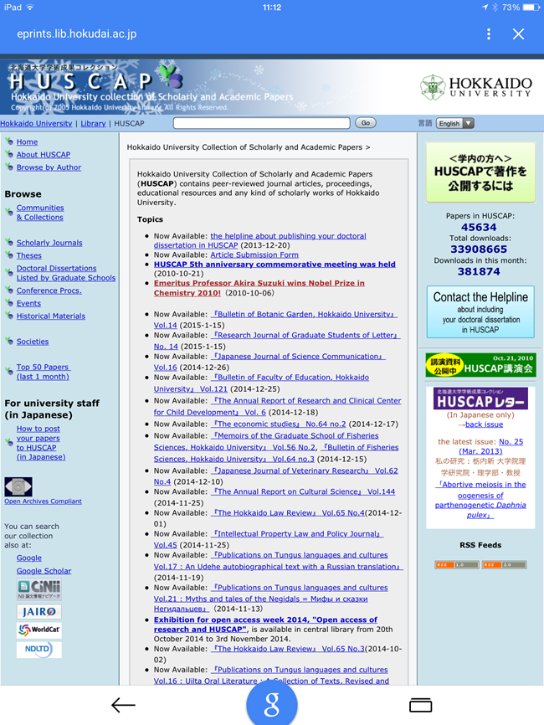



HUSCAP(1）
Hokkaido University
Collection of
Scholarly and
Academic Papers
Cf.) Hasｋap
（Lonicera caerulea,
Blue-berried
Honeysuckle））
Notes:
Well, this is our institutional repository, “Hokkaido University Collection of Scholarly and Academic Papers”. We call it “HUSCAP”.
“HUSCAP” is an acronym, named after a kind of berry growing naturally in Hokkaido.
＜HUSCAPについて＞
・正式名称「北海道大学学術成果コレクション」
・通称のHUSCAPは、英語名の頭文字から取ったもの。北海道に自生するベリーの一種「ハスカップ」に因んだ名称。

Slide 5

HUSCAP(２）
・ Institutional repository of Hokkaido University.
・ Opened: July, 2005. (on a trail basis; formally opened in April, 2006)
・ Base system: DSpace 1.8 JSP-UI
・ More than 45,000 full text articles; self-archived articles 20%, dissertations 3%, departmental papers 67%

Slide 6

HUSCAP(3）
・ Hokkaido University strongly recommends that all researchers who belong to the university and conduct education and research activities should publicize their diverse and high levels of achievements on this Collection site in accordance with the Hokkaido University Collection of Scholarly and Academic Papers' Operational Guidelines. (Advocacy policy)

Slide 7
HUSCAP(4）
Services for our researchers:
・ Mediated archiving service
・ Confirming publisher’s policies for self-archiving
・ Notification of articles which can be deposited in repository
・ Personalized statistics page
・ Monthly E-mail service
  How many times downloaded
  Par article, par domain

Slide 8
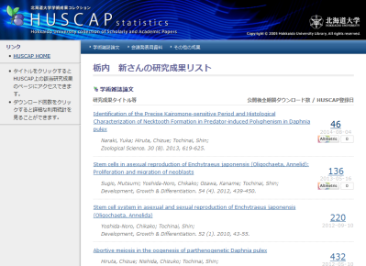
HUSCAP(5)

Slide 9
DRF(1)
Digital Repository Federation
・ IR managers community of Japan.
・ Established 2006, by NII’s CSI(Cyber Science Infrastructure) project.
・ CSI project finished FY2012.
・ Members: 156 institutions (as of Jan., 2015)
< less than half >
・ Fee free, no benefits.

Slide 10
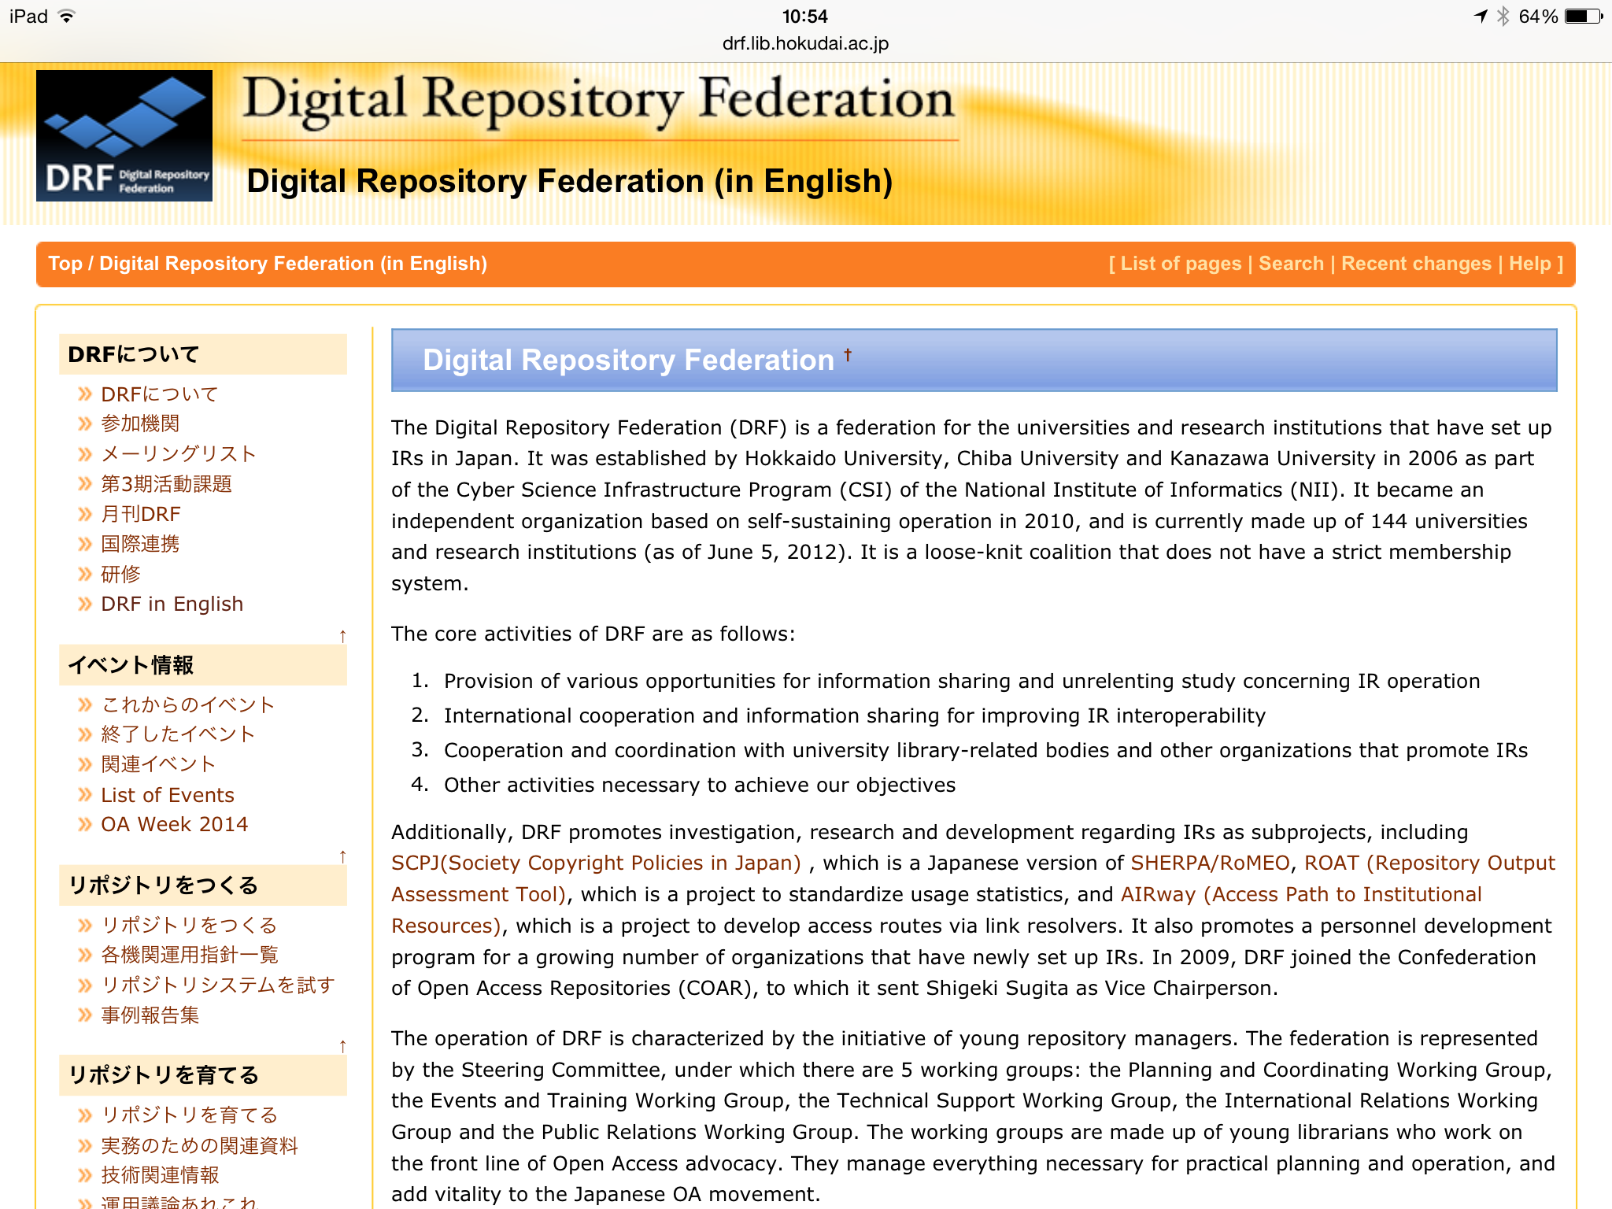
DRF(2)

Slide 11
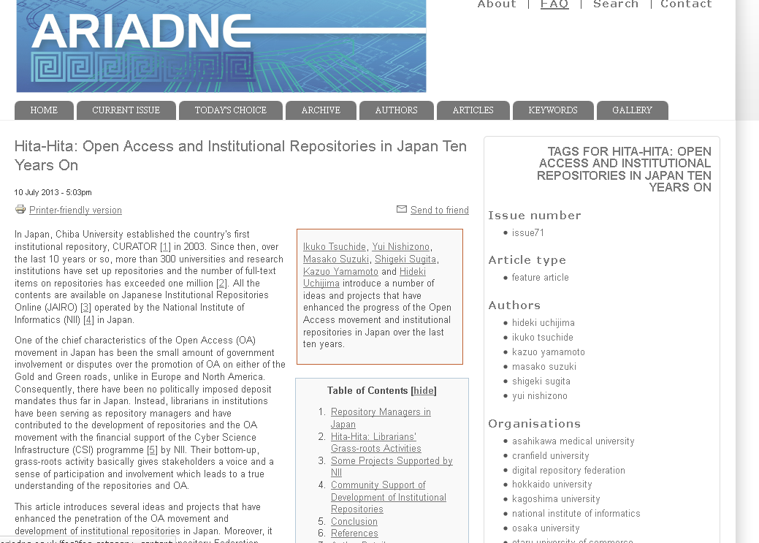
DRF(3)
・ ”hitahita” † – institutional OA advocacy in Japan
- grass-roots activities of repository
managers
† onomatopoeia for water rising, slowly but steadily
Tsuchide, I. et al. (2013) “Hita-Hita: open access and institutional repositories in Japan ten years on” Ariadne issue 71. http://www.ariadne.ac.uk/issue71/tsuchide-et-al

Slide 12
DRF(4)
・ Activities in FY2014:
Information sharing (e.g. newsletter “DRF Monthly”, wiki page)
Study sessions on mailing list
Co-sponsored by Institutional Repositories Promotion Committee
Forum (Libraｒｙ Fair ＆ Forum)
Training sessions

