Slide 1
France/Japan joint Meeting on Open Access January 28,2015
Case study of Open Access Practice in Japanese Academic Library
“CURATOR : Chiba unibersity repository for access
to outcomes from research”
Chiba University
Misumi Taro

Slide 2
Chiba University
Faculty 1,200
Staff 1,800
Undergraduate Students 10,800
Graduate Students 3,500
Undergraduate Programs
Letters, Education, Law & Economics,
Engineering, PharmaceuticalScience, Nursing Science,
Horticulture, Medicine
Graduate Programs(Master’s andDoctoral)
Humanities, Education, Social
Science, Science and Technology,
Medical and Pharmaceutical Science,Law School
1 University Hospital
19 Research Centers
http://www.chiba-u.ac.jp/e/

Slide 3
We are always first
Chiba University Library is the pioneer
in Japan!
・Library web site 1994-
・www OPAC 1994-
・Institutional Repository 2005-
・Partnership with Scirus 2006-2014
・JAIRO Cloud migration experiment 2013-
・Experiment Project to register DOIs
for Research Data 2014-

Slide 4
CURATOR
CURATOR (Chiba University's Repository for Access to Outcomes from Research) captures, preserves and makes publicly available intellectual digital materials from research activities on Chiba University campuses, including peer-reviewed articles, theses, preprints, statistical and experimental data, course materials and softwares. CURATOR is intended to function as the portal for the outcomes from Chiba University's research activities. The University Library is responsible for building and operating CURATOR under the guidance of the Faculty Committee for Improved Scholarly Information Availability, which commissioned by the Library Board of Faculty Representatives to systematically promote and arrange disseminative activities by the University.

Slide 5
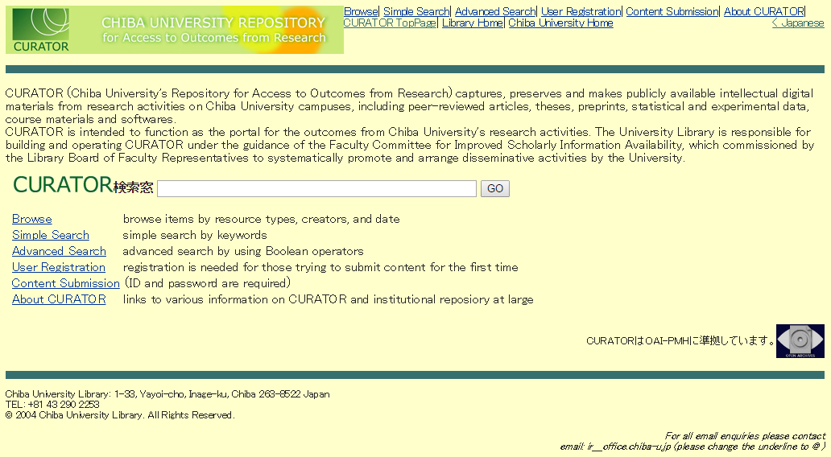
CURATOR
http://mitizane.ll.chiba-u.jp/curator/index_e.html

Slide 6
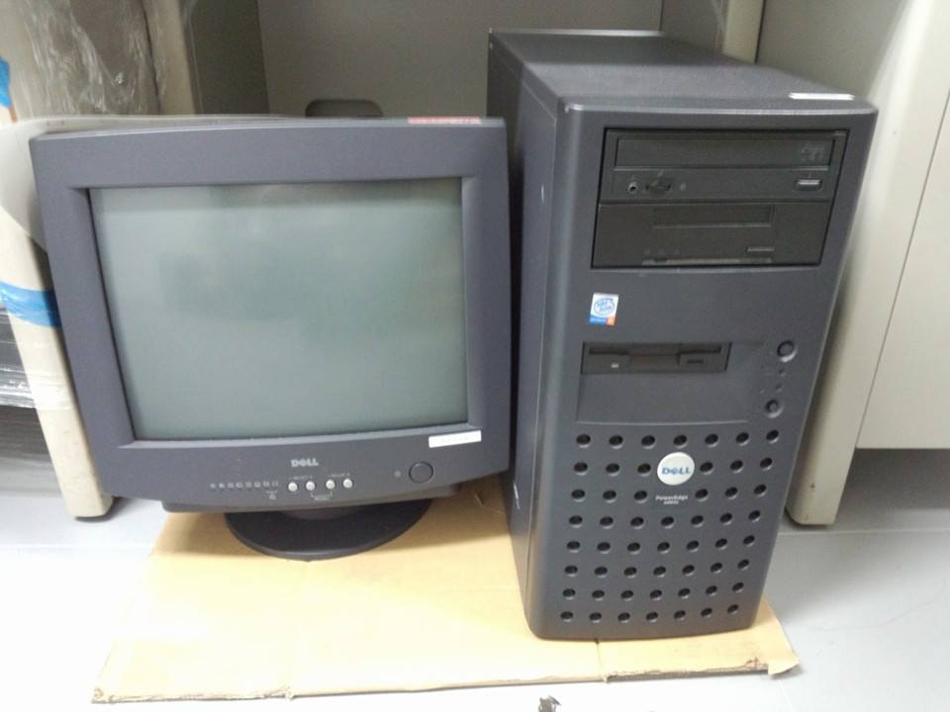
Japan’s First IR Server

Slide 7
CURATOR’s Progress
2002 The Library prepared to launch
an institutional repository
2003 Tested the prototype
2004 The repository project formally
approved
2005 CURATOR was released officially

Slide 8
CURATOR
System : E-Repository
・ Custom-made→commercialized after
・ Not using open source software
OS: Linux DB＋ Oracle

Slide 9
Contents Number
resource type | Number
Journal Article | 25,175
Thesis or Dissertation | 958
Departmental Bulletin Paper | 7,515
Conference Pape | 30
Presentation | 121
Book | 35
Technical Report | 35
Research Paper | 803
Preprint | 12
Learning Material | 210
Data or Dataset | 52,223
Others | 2,438
Total | 89,555

Slide 10
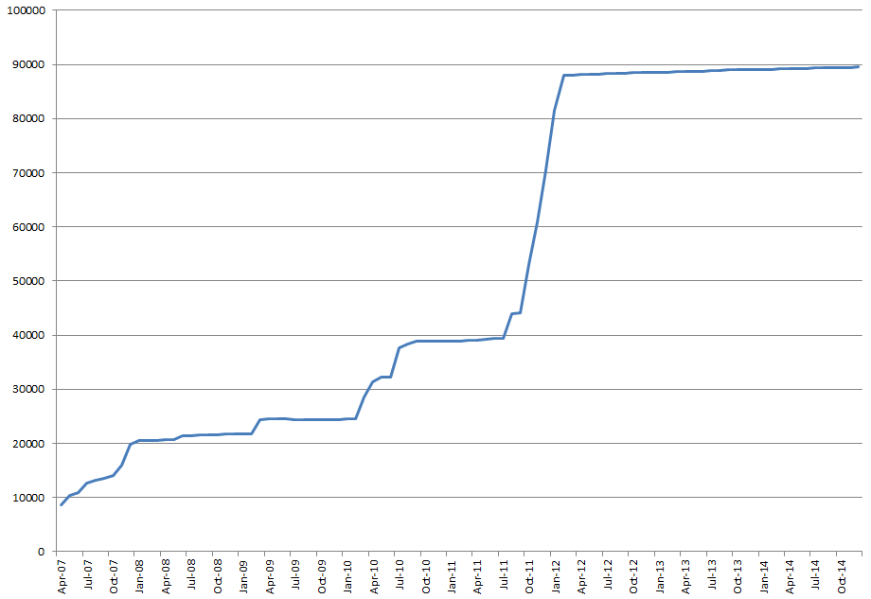
Number of Contents

Slide 11
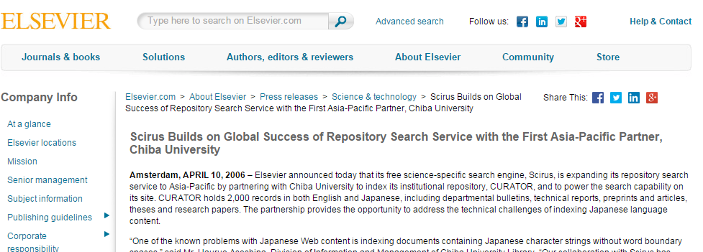
Partnership with Scirus （2006-2014)
・ Indexing Japanese character strings
・ Implement Scirus’s search engine for CURATOR
→ Enables full text search in PDF files
・ CURATOR’s contents have become searchable from Scopus

Slide 12
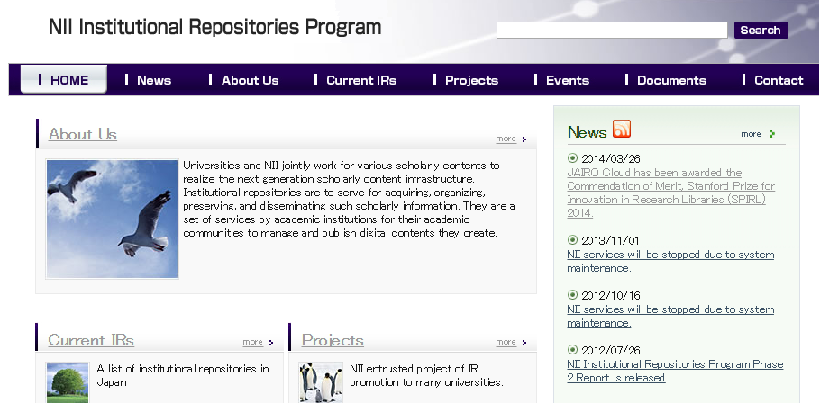
IR Program of NII
We also have been playing an important part of the Institutional Repository Program of National Institute of Informatics (NII). (http://www.nii.ac.jp/irp/en/).

Slide 13
Chiba University leading projects
2006-2007 | Development of IR evaluation system
2006 | Research community creation support
2007 | Co-evolutionary research community creation support
2008-2009 | In vivo experiment of data curation for repository-based e-Science
2008-2009 | Framework for sustainable upgrading of repositories by way of creation of a user community
2008-2009 | Standardization of usage statistics for IR evaluation
2010-2012 | Standardization and upgrading of institutional repository output assessment

Slide 14
Chiba University participating projects
Year | Title
2006 | Development of sharing system of copyright policy
2006-2009 | Digital Repository Federation (DRF)
2007 | Copyright management project relating to open access and self archiving
2007 | Access path to Institutional Resources via link resolvers
2010-2012 | Development of human resources who take charge of institutional repositories

Slide 15
“Everything Welcome” policy
We welcome every Digital materials from research activities on Chiba University campuses, including peer-reviewed articles, theses, preprints, statistical and experimental data, course materials and softwares.

Slide 16
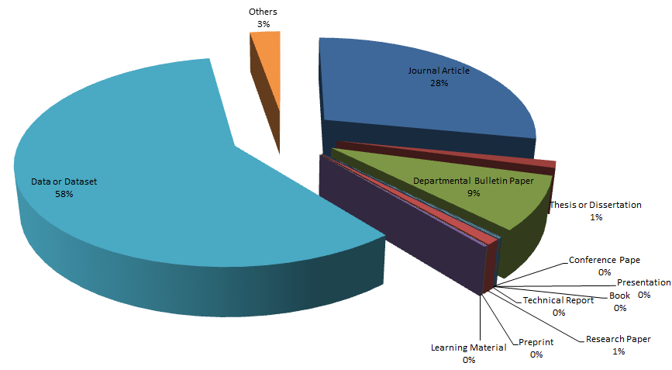
Content ｔｙpe (CURATOR)
2015.1

Slide 17
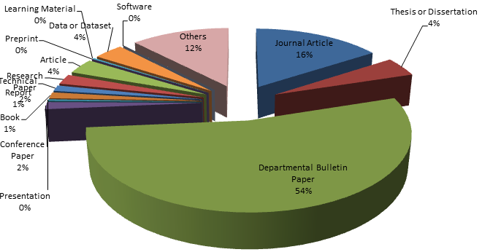
Content type (IR systems in Japan)
2015.1

Slide 18
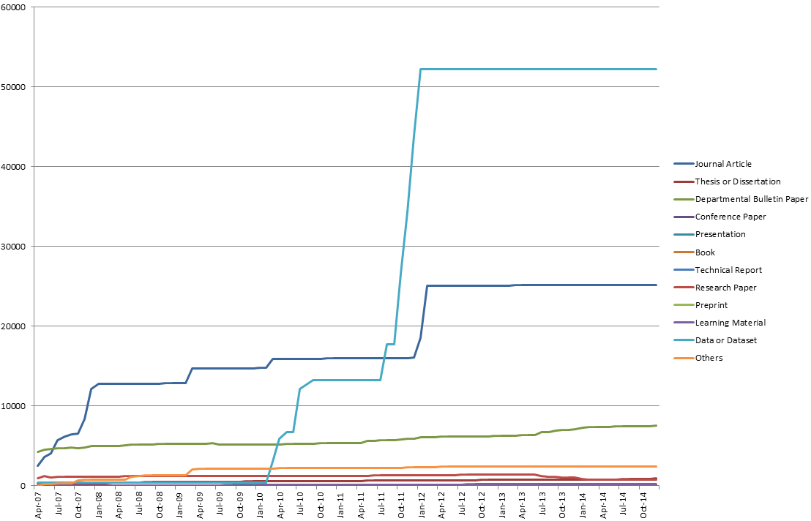
Contents Number

Slide 19
Overlay journals list

Slide 20
Publish flow of bulletin
researcher
editorial board
紀要
Printing
company
submitt
order
≠ publisher
Faculty
peer review
& accept
＿＿＿＿＿＿
Journal
librarians
________
________
________
________
________
CURATOR
PDF file
register
printed material
Chiba University
publish
publish
Made in Chiba University → easy handling

Slide 21
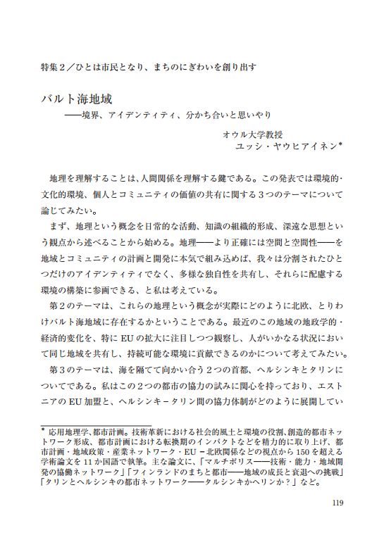
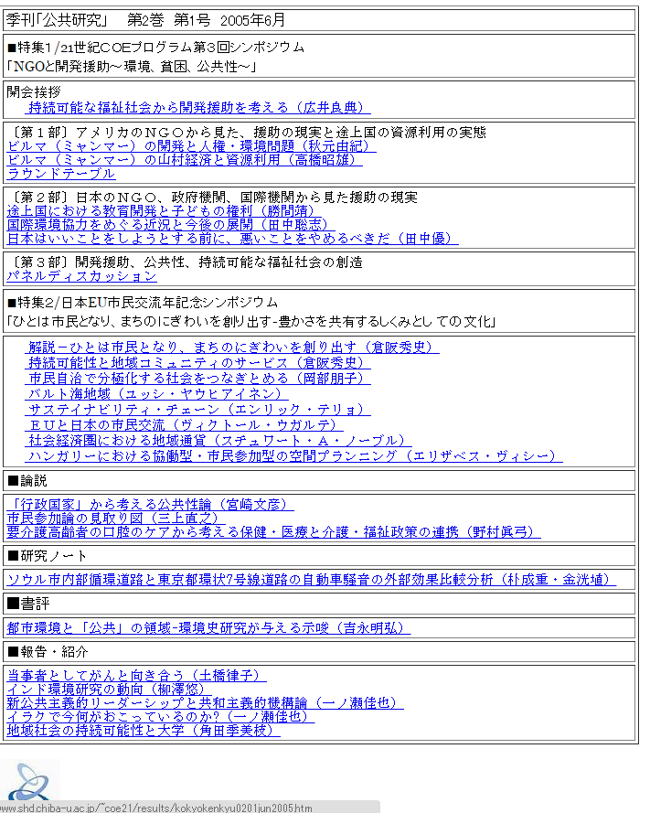
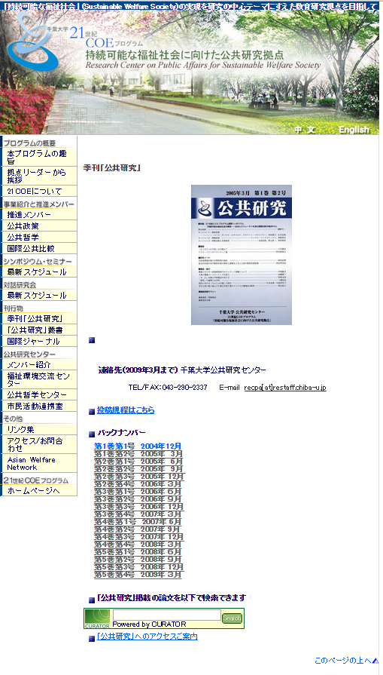
Overlay journals
Coverpage index
Full-text +metadata
Web Server
CURATOR

Slide 22
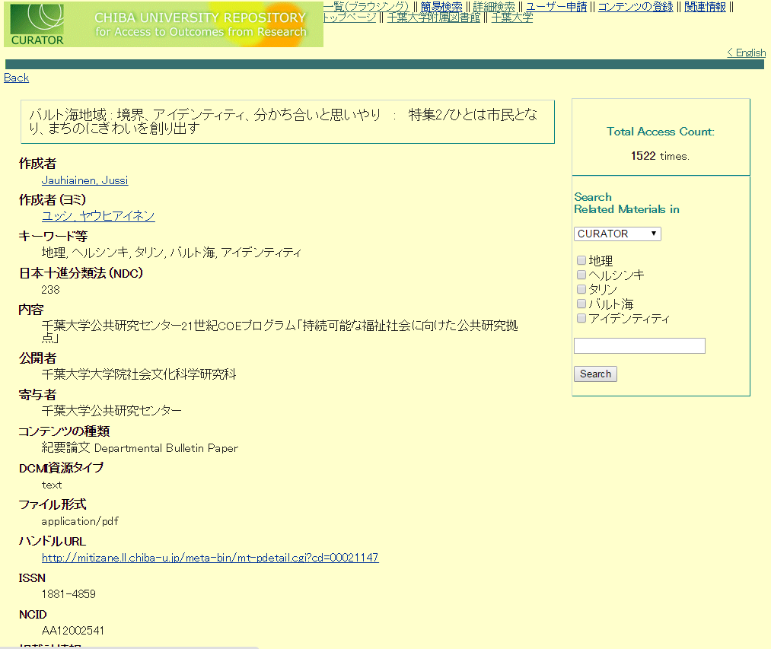
Overlay journal
metadata
Search Window
Search paper by CURATOR!
Both side benefit from the Repository
Requirements of faculty
→ They need methods of dissemination
Responsibility of library
→ The library should collect and provide access
to materials produced in the university
full-text

Slide 23
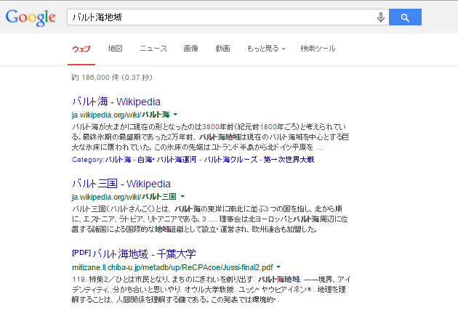
Overlay journal

Slide 24
e-Science Project
Surveys and research concerning the possibility of collaboration between e-Science projects and IRs
Lead institution: Chiba Univ.
Contributing institution: Kanazawa Univ. Kyushu Univ. Hokkaido Univ. Osaka Univ.
・Tagging images with interoperable metadata suitable for uses by various communities of researchers and students
・Development and appraisal of the platform system
・Effective and efficient management system for intellectual inputs and outcomes for research and higher education

Slide 25
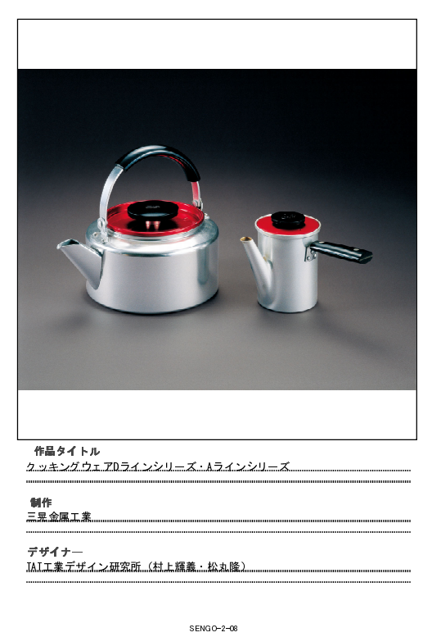
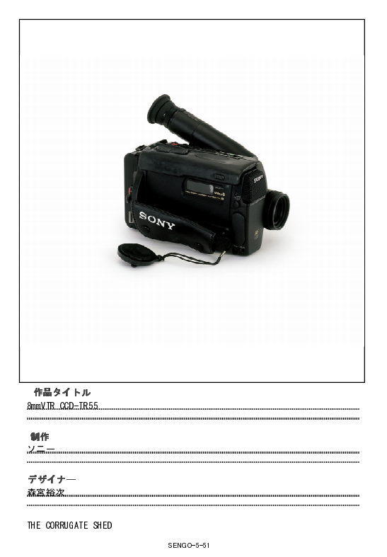
Contents Design

Slide 26
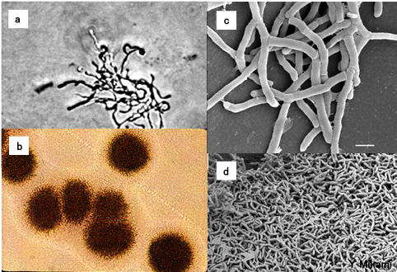
Dataset

Slide 27
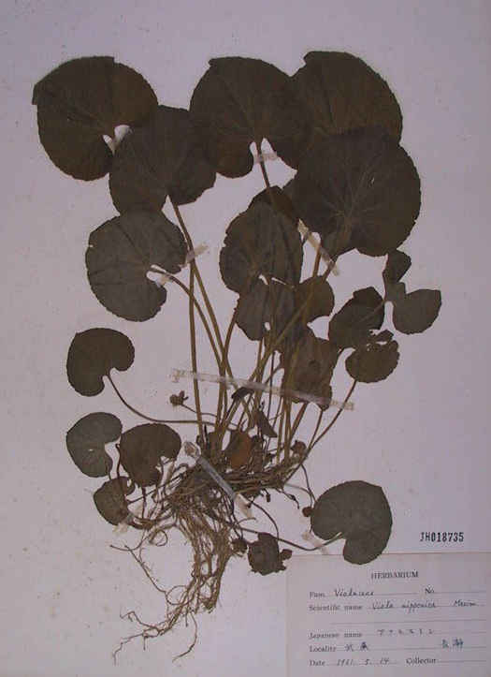
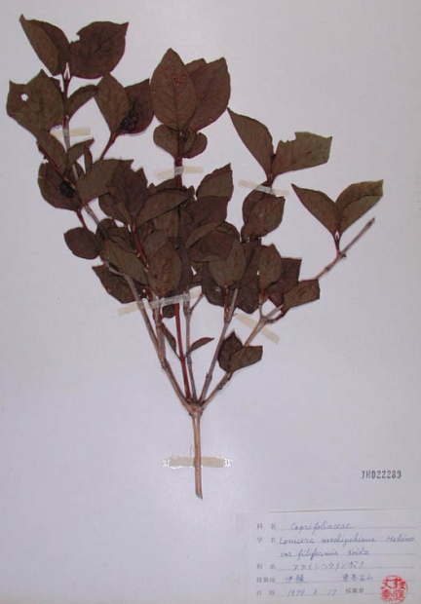
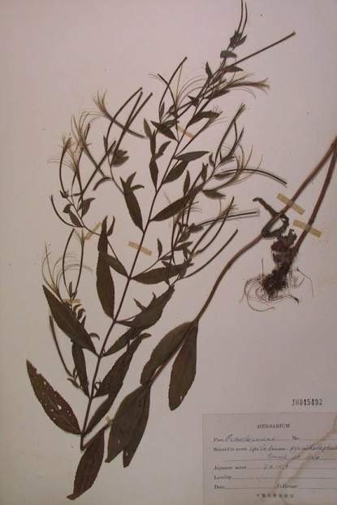
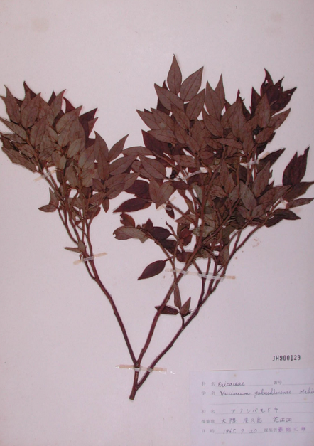
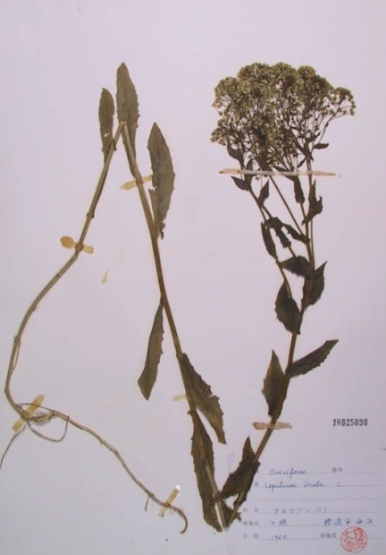
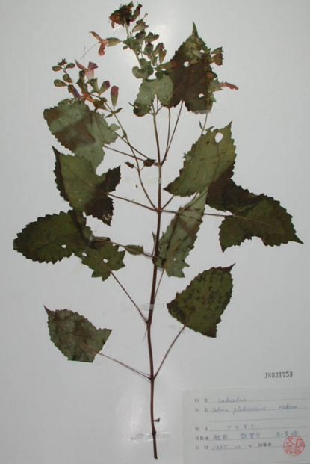
Dataset

Slide 28
CURATOR, Next Challenge!!!
JAIRO Cloud migration experiment
Replace E-Repository system with
new JAIRO Cloud system
2) Experiment Project to register DOIs
for Research Data
Register DOIs for contents
3) Extend the metadata schema,
not only for paper, but also for various contents
such as research data, learning materials
industrial design etc.

Slide 29
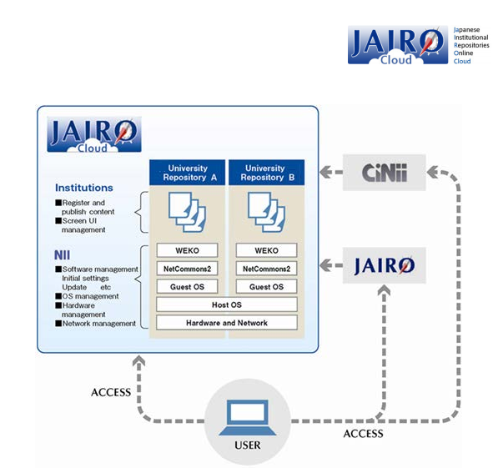
1) JAIRO Cloud migration experiment
We participate in the JAIRO Cloud migration experiment (JAIRO Cloud is a SaaS type IR cloud
service developed
and operated by NII).

Slide 30
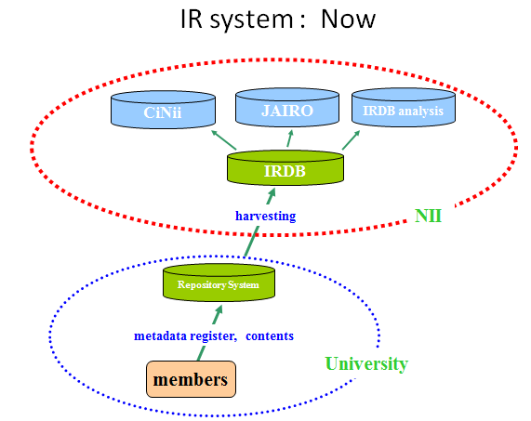
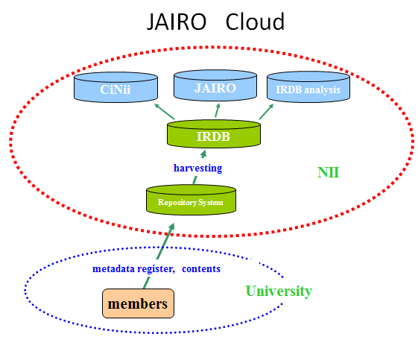
JAIRO Cloud migration experiment
JAIRO Cloud is a SaaS type IR cloud service developed and operated by NII, and we articipate in the JAIRO Cloud migration experiment .
To search and download contents, there is no difference between CURATOR system(now) and JAIRO Cloud.

Slide 31
Work Flow
Mxtract the metadata and full-text file from Old Server
Data convert
Register
CURATOR
PC
NII
E-Repository
Server
Metadata Covert fileter
JAIRO Cloud
MetadataTSV
Regster Tool
（SCｆW)）
Data extraction
PDF
①
③
②
④
⑤
手順 | ①Installing a data extraction tool | ② extracting the data from CURATOR server | ③Installing a register tool | ④ making a metadata convert filter | ⑤ register

Slide 32
2) Experiment Project to register DOIs for Research Data
We particiipate in Experiment Project to register DOIs for Research Data(2014-2015).
Japan Link Center
Founded in March 2012
Aimed to register DOIs for academic contents produced in Japan or in Japanese, to circulate information in Japan and overseas.
Controlled by four national organizations:
Japan Science and Technology Agency (JST)
National Institute for Materials Science (NIMS)
National Institute of Informatics (NII)
National Diet Library (NDL)

Slide 33
Register flow
Chiba university
Database of researcher in Japan
Text,
Data
Library
register
registar
submt
Jornal
Research
Map
link
IR
Researcher
DOI
DOI
harvest
JaLC
DOI
IRDB
harvest
NII

Slide 34
3) Extend the metadata schema
・DOI
・Researcher ID
・ Funder information
（FundRef, program name, year,
project number）
・ Elements for various contents
(especially, research data)
.

Slide 35
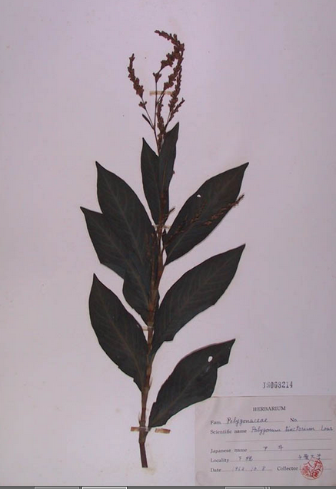
junii2(standard metadata format for IR in Japan)dose’t have field to input necessary value such as sampling location, sampling date, sample number, sampler , so descript in description field.

Slide 36
ToDo list
1) Metadata schema for new JAIRO Cloud
2) Data migration from E-Repository
to JAIRO Cloud
3) Experiment to register DOIs
for Research data
4) Data management Policy

Slide 37
Our Future
Chiba University
Open
Access
University
Publishing
Industrial
Design
Student
E-Journal
E-Book
CURATOR
Research Data
Learning Materials
Faculty
Article
Paper
Center for Chiba University
Digital Scholarship
Staff

Slide 38
Thank You

