Slide 1
Institutional Repositories in Japan: an overview
Masamitsu Kuriyama
Tokyo Metropolitan University
France/Japan Joint Meeting on Open Access Jan. 28, 2015
@French Embassy in Tokyo, Japan

Slide 2
Agenda
Current status of IRs in Japan
MEXT’s open access mandate for PhD theses
Support program of National Institute of Informatics (NII)
Digital Repository Federation (DRF) and Institutional Repository Promotion Committee
Conclusion

Slide 3
Growth in the number of IRs in Japan
Currently: 388
(as of Jan. 2015)
Source: NII Institutional Repositories Program http://www.nii.ac.jp/irp/en/archive/statistic/irp_2014_statistic.html

Slide 4
Content growth
Source: NII Institutional Repositories Database Contents Analysis
http://irdb.nii.ac.jp/analysis/index_e.php

Slide 5
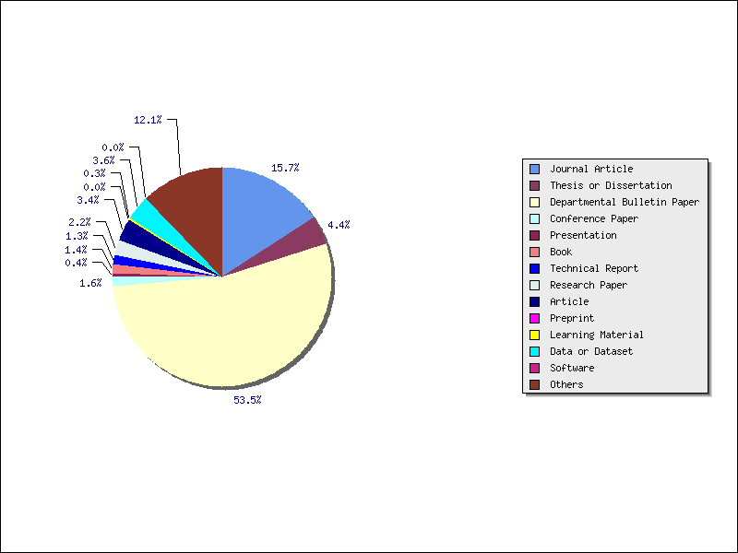
Breakdown of content by resource type (ratio)
Journal Article | 226,641 (15.7%)
Thesis or Dissertation | 62,714 (4.4%)
Departmental Bulletin Paper | 770,761 (53.5%)
Conference Paper | 22,807 (1.6%)
Presentation | 5,619 (0.4%)
Book | 19,603 (1.4%)
Technical Report | 18,744 (1.3%)
Research Paper | 32,240 (2.2%)
Article | 49,368 (3.4%)
Preprint | 378 (0.0%)
Learning Material | 4,053 (0.3%)
Data or Dataset | 52,418 (3.6%)
Software | 29 (0.0%)
Others | 174,836 (12.1%)
SUM | 1,440,211
Source: NII Institutional Repositories Database Contents Analysis
http://irdb.nii.ac.jp/analysis/index_e.php

Slide 6
Characteristics of IR Content in Japan
More than half are “Kiyo Ronbun (department bulletin papers)”
“Kiyo (Department bulletin)”
Most authors are the department faculty members
Edited and published by the department faculty
Cost to publish is covered by the department
Not for sale and small circulation
Peer review is sometimes loose and articles in it are not so highly regarded (especially in natural sciences)
Journal articles’ deposit rate is generally low
No green OA mandate
PhD theses begin to increase due to MEXT†’s mandate
† Ministry of Education, Culture, Sports, Science & Technology

Slide 7
MEXT’s open access mandate for PhD theses
MEXT revised the decree and mandated open access to doctoral dissertations in March 2013
The decree requires to publicize the entire thesis on the Internet within one year unless there is a special reason
Theses are made publicly available through IRs of PhD awarding institutions
National Diet Library (NDL) will harvest them from IRs (after Feb. 2015) and preserve them in electronic format

Slide 8
Support program of National Institute of Informatics (NII)(1)
NII played a pivotal role in the growth of IRs entrusting various projects to selected institutions (2004-2012)
IR construction projects
2004 The experimental project "Implementation of IR software" with 6 university libraries
2005 The pilot project "introduction and operation of IR" commissioned to 19 university libraries
The full-fledged project: Construction and operation of IR. 57 university libraries in 2006, 70 in 2007

Slide 9
Support program of National Institute of Informatics (NII)(2)
SCPJ (Society Copyright Policies in Japan)
Japanese counterpart of the SHERPA/RoMEO
ROAT (Repository Output Assessment Tool)
Standardized counting mechanism for downloads
JAIRO† (Japanese Institutional Repositories Online)
A portal to Japanese IRs similar to the OAIster
JAIRO† Cloud (2012- ) ^{†pronounced as “gyro”}
A SaaS type IR cloud service
Utilized by many small institutions which lack budget and skills to build a repository on their own
60% of IRs in Japan are now on the JAIRO Cloud

Slide 10
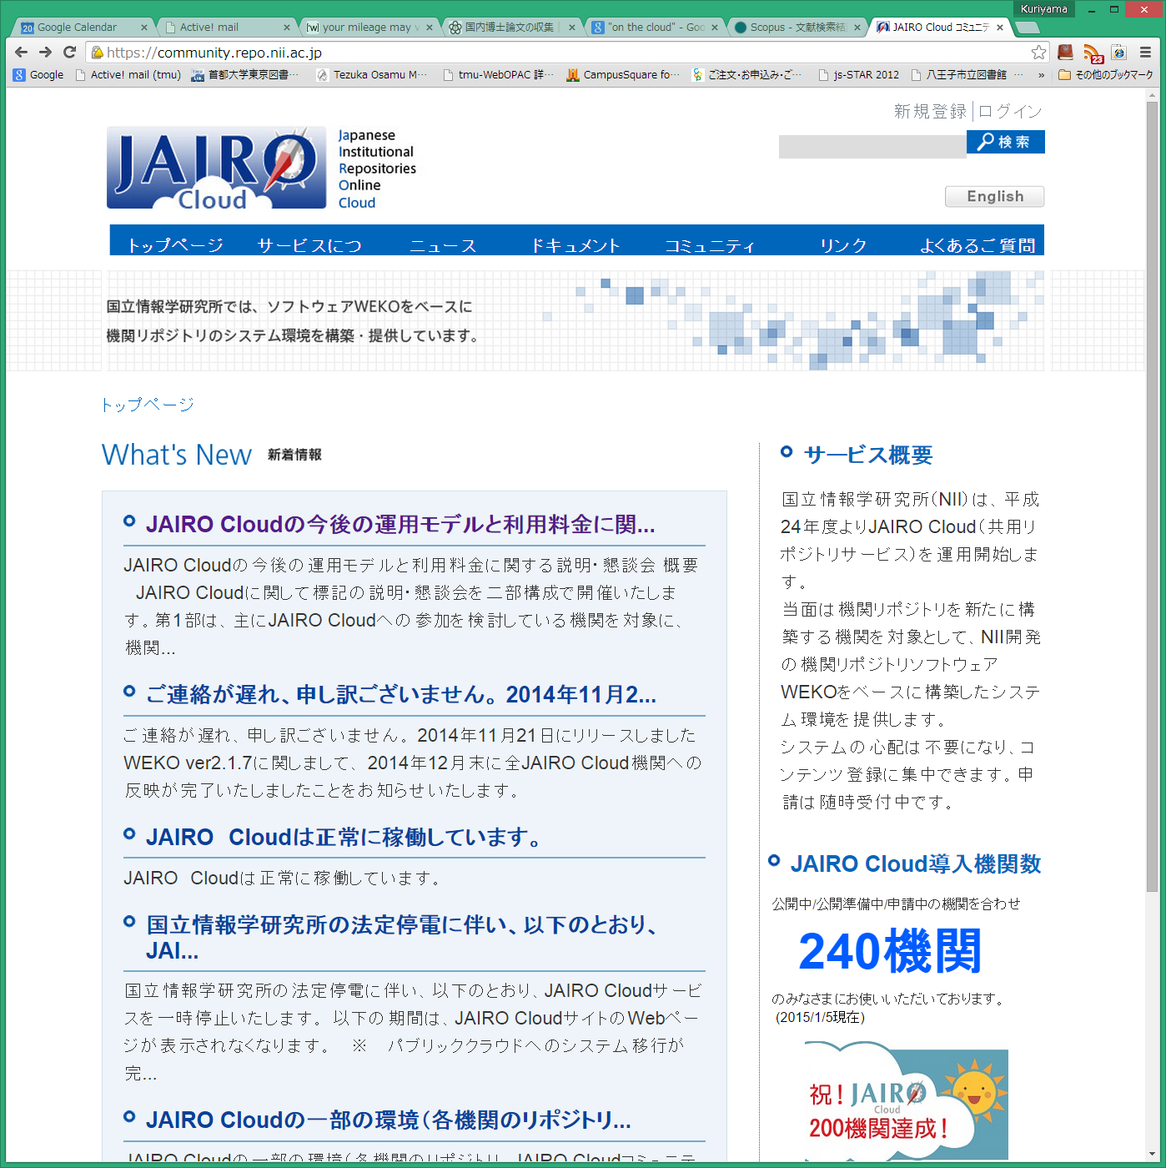
NII Institutional Repositories Program homepage
JAIRO Cloud homepage (in Japanese)

Slide 11
Digital Repository Federation (DRF)
Launched as one of the projects supported by NII
A membership organization which consists of some 150 IRs in Japan
A member of the Confederation of Open Access Repositories (COAR)
Promotes OA and IRs with grassroots effort
Activities are now limited, because NII’s financial support for DRF ended in 2012

Slide 12
Institutional Repository Promotion Committee
Established in 2013 under the cooperation between NII and university libraries
Committee members consist of university library staff and some researchers
Many of them are also core members of DRF
3 working groups
Content
International cooperation
Technical issues
The committee and DRF, complementing with each other, begin to lead Japanese IRs

Slide 13
Conclusion
IRs in Japan grew significantly from 2004 and the number exceeds 300 in 2014 (388 as of Jan. 2015)
MEXT mandated open access to PhD theses through IRs in March 2013
NII played a pivotal role in the growth of IRs with support for various projects and provision of JAIRO Cloud
DRF is a membership organization of Japanese IRs and promotes open access with grassroots effort
IR Promotion Committee was established in 2013 and begins to lead Japanese IR activities

Slide 14
Merci beaucoup!

