Slide 1
KeiO Associated Repository of Academic resources
Keio University
Kazuko Matsumoto
Notes:
Hello, my name is Kazuko Matsumoto. Thank you for giving me an opportunity to join this seminar and introduce you our repository, KOARA

Slide 2
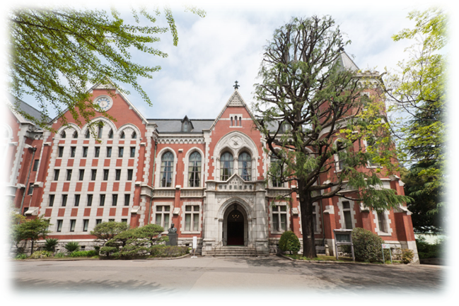
Today’s Presentation
A little about Keio University
KOARA: overview and challenges
Notes:
Today I would like to give you a brief introduction of Keio University and an overview and challenges of KOARA.

Slide 3
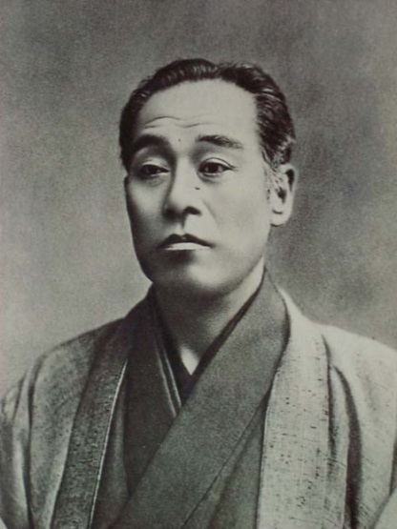
About Keio University
Founded by Yukichi Fukuzawa, a Japanese educator in the 19th century
Mission
“Foster leaders of society with a spirit of independence and self-respect”
9th globally among universities that produced the most CEOs (Forbes) in 2014
Notes:
Keio is a private university funded by Yukichi Fukuzawa, if you have a ten thousand yen bill, you can see his portrait on it. He opened western learning school in 1858 and it expanded to Keio University today. Keio is the oldest University in Japan. Keio’s mission is to foster a leader of society with independent and self-respect sprit.

Slide 4
About Keio University
33,000 Students （28,700 undergrads) 10 Undergraduate Faculties
14 Graduate Schools
13 Research Centers & Institutes
1 University Hospital
5,500 Faculty (Full time:1,400 ) SSH:STM=64%:46%
Notes:
In Japanese higher education system, private universities are expected to be focused on college education. 77.6% undergraduates are studying in private universities in Japan . So the majority of Keio are also undergraduate students.
Keio has 10 undergraduate faculties and 14 graduate schools. 13 research centers and Institutes. For details, please refer to our general information.
Keio has 5,500 teaching staff but fulltime number is only 1400. We have excellent researchers, but teaching and supporting the students should be a priority over the research for most of the staff. When we divided the researchers in research area, ratio for SSH researcher is 64% and STM is 47%.Those background and figures reflect on the KOARA’s contents and our direction.

Slide 5
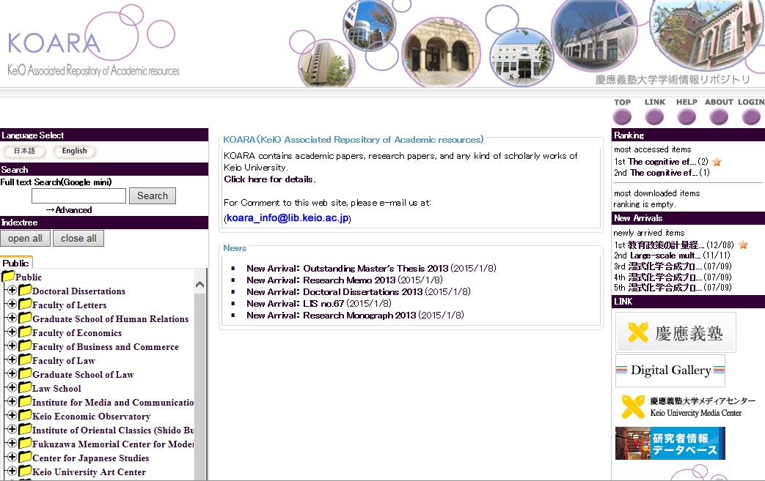
KOARA http://koara.lib.keio.ac.jp/xoonips/
Notes:
This is KOARA top page. Probably you are the first lucky visitors to see KOARA English page. Our system engineers think that most of the visitors are redirected from Google or CiNii. So they think few people can appreciate to see the English page. But finally I can persuade them to make one.

Slide 6
KOARA: Overview
Contents (total: 43,279 items)
Academic papers published by associated academic societies & affiliated organizations (23,338:53.9%)
Doctoral dissertations (3,966:9.2%)
Research papers funded by Japanese government (2061 4.8%)
No preprints
More than 90 % is in Japanese and on SSH
657th in the “Ranking Web of Repositories”
Notes:
Let’s take a look at the contents. As of December 2014, we have 43,279 items registered in KOARA. 54% is articles of the journals published by Keio associate academic societies and affiliated organizations; I would like to mention them Keio Journals in my presentation. We have PhD. Thesis, and research papers but we have no preprints. And most distinguishing aspect is more than 90 % items in japanese and topics are on SSH areas.
Our ranking is low in web of repositories. We may rank higher if Google extracts our PDF as a rich text files.

Slide 7
Notes:
This is our contents detail in IRDB. And I would like to make it clear, what we call “affiliated organization journal” is categorized to “DAIGAKU KIYO” or Departmental Bulletin in IRDB. But ours are mostly published by the research centers and institutes not by the Department.

Slide 8
Usage Statistics
Notes:
This is a usage statistics from 2009 to 2014, Average access is 1.5million per month and full text down load is 225,000 per month. You can see the usage is constantly increased.

Slide 9
History and collaboration
Joined the NII project 2005-
Digitization of academic papers of Keio journals
CSI project
System link with CiNii
Collaboration with RIKEN: XooNips system
CMS with database
Metadata: MODS complying with OAI-PMH
Library supports the Keio journal editors 2007-
Formats
Rights
Notes:
Now let me look back on KOARA’s history and collaboration.
We can say that NII has been a drive for IR in JAPAN.
Applying to departmental bulletin digitization program by NII is an important step for KOARA. Quite a few contents we offer are digitized by this project.
In CSI project, we have learned and shared knowledge and skills to administrate IR from the participants.
CiNii is the basic bibliographic database in SSH. CiNii’s API make it possible to search CiNii and get full text form IR on our OPAC platform. I think it is a breakthrough for learning and researching process.
About system software, Keio chose XooNips. It was developed by Riken Brain Science Institute. RIKEN developed this system as an infrastructure for their databases to share different types of data on the Internet based on a content management system (CMS). Our engineers had faced language character code problems several times, so they prefer to work with system developed in Japan.
And XooNips applies MODS for metadata. As you know MODS are developed by Library Congress based on MARC, so librarians feel more comfortable to learn MODS and create metadata for KOARA’s contents.
When we started to digitize Keio journals, we learned the researcher in SSH were eager to share their academic papers on the web. At the same time we realized their knowledge on digital publishing and copyright are inefficient not mention to metadata.
We set several meetings with them to eliminate their doubt and anxiety, made handouts on digital formats and copyright law.

Slide 10
KOARA: Current role
Provides a platform for SSH researchers to
disseminate their scholarly information
Increases Keio recognition in the world
Meets the government’s open access policy
Doctoral dissertations
Grants-in-Aid for Scientific Research Reports
Notes:
I would like to summarize current KOARA’s role.
Keio journal editors learned most efficient way to send out their scholarly contents on the web are using KOARA.
It’s awkward to say that we are providing the gold journals, because some people raise a question about a quality of the journal published under University name. and they rely on the membership fee to publish, they set embergo period to OA. But so far KOARA have succeeded in collaborating with small academic society to distribute their journal to the world.
The journal editors are happy with usage and good response from external researchers. We can say that KOARA also plays a role of increasing recognition of Keio University.
We also follow the government policy of open access mandate. PhD Thiess and government-aided scientific research reports are added accordingly.

Slide 11
KOARA: How about STM?
No preprints in KOARA. Why?
Researchers are busy
No incentives and no penalties
Researchers have their own ideas
Top-down decision making is not Keio style
Researchers recognize importance of OA
They pay APC and choose OA journals
KOARA could be one of their choices,
But not attractive for STM researchers.
Notes:
We have been encouraging researcher to register to KOARA , but we have not
Got very few positive reactions from STM researchers .
The reason why we could not lure STM researchers are:
1. Researchers are busy.
Keio faculty has a responsibility in education besides their own research. They also work hard to get fund and often commit the management of the university.
2.Keio set no incentives or no penalties to submit their academic output to KOARA.
3. Based on Keio’s mission, they prefer to have their own way.
Even Keio developed Researcher Directory and make it compulsory for faculty to register their information, registration rate is low. I would say top-down decision making doesn’t work under Keio Culture.
For transmission of their scholarly activities, researchers use their own site, SNS, subject repository, which is easier or suitable for their research environment.
STM researchers want to submit their papers to scholarly journal of prestigious publishers or international associations. They don’t care very much about reputation of Keio, but they do want to be acknowledged by the peer researchers.
So researcher knows the importance of OA, they willingly to pay APC. In last two years Nature and other leading academic associations start publishing their own OA, Keio’s researcher are now posting their papers to those emerging OA especially in medeical science.
They think registering their papers or preprints to local system is time-consuming.
KOARA could be one of the choices for OA, but unfortunately it is not recognized as a choice for STM researchers.

Slide 12
KOARA: Challenges
Gains global recognition
Translation into English (Abstracts)
Collaborate with editors to leverage journal quality to be indexed by major DBs
Builds better online presence
Persistent URL to DOI
Local researcher ID to ORCID
Save the researchers’ time
Notes:
For my last presentation, I would like to talk about our challenges.
KOARA is a platform for keio SSH researchers and working very well now. Those contents are used for undergarduate learnings too. But we can make our contents more accessible from oversea. Increase of accuracy of machine translation makes Japanese article translated into any languages. But first we have to make them discovered. Right now we are working on translating the abstracts of Keio journal into English. It is very small step, but same time we are discussing with Keio journal editors to invite foreign editors and change the policy to write at least an abstract in English, so that Keio Journals can be indexed in major bibliographic databases, such as SCOUPAS.
And how we make KOARA attractive to STM researchers? If make it charming enough, they can’t help offering their preprint.
But we don’t have an answer yet. We think most important challenge is to establish the infrastructure of academic information distribution in Keio and to build the better online presence of individual researcher. Now we are planning to introduce DOI for KOARA contents, and assigned ORCID for individual researcher along with researcher Directory. We are considering replacing existing in-house directory for commercial platform that connected with major bibliographic database. So researchers do not need to register their information to local system. If we can reduce faculty time and make good online presence for them, STM researcher might pay attention to and rely on KOARA.
The librarians are expected to use their knowledge and skills to beyond the wall of organization. Our ultimate goal is to scontribute to the world scholairy community worldwide.

Slide 13
Thank you kazuko@lib.keio.ac.jp
Notes:
Thank you for your attention.

