Slide 1
Open Access and scientific information policies in France

Slide 2
French-Dutch delegation
Claude Kirchner, CEO for Science and Technology, Inria
クロ－ド・キシュネ－ル、フランス国立情報学自動制御研究所 科学技術最高責任者
Laurent Romary, Research Director of Inria, Director of DARIAH (Digital Research Infrastructure for the Arts and Humanities)
ロラン・ロマリー、フランス国立情報学自動制御研究所 リサ－チディレクタ－
Pascal Estrailler, Specialist of Computer Science, Direction-General for Research and Innovation
Research and Innovation Strategy Dept. – Mathematics, physics, nano-sciences, ICT Sector
Ministry of National Education, Higher Education and Research
パスカル・エストライエ、 フランス国民教育・高等教育・研究省研究・イノベ－ション総局
研究・イノベ－ション戦略部 コンピュ－タサイエンス担当
Alexandre Moatti, Associate researcher, SPHERE (Philosophy and Science History Laboratory), Paris VII University
アレクサンドル・モアッティ、パリ第7大学アソシエイト リサ－チャ－
Jos Beaten, General Director, CWI (Centrum Wiskunde & Informatica) - National research institute for mathematics and computer science in the Netherlands
オランダ情報工学数学研究所 所長

Slide 3
Open access and Scientific information
Providing the researcher with the means to work
Providing access to publications
Subscription policy
Giving him/her the means to record and disseminate his/her activity
Research repository
Dealing with additional research data
laboratory notes, observations, primary sources, databases
Difficulties
Coping with the high costs and IP policies of traditional scholarly publishing
Accommodating with the development of new technologies and practices
Getting a comprehensive view on the researcher’s production

Slide 4
Recent advances on open access to scientific results in France
Geneviève Fioraso, Ministre de l’Enseignement supérieur et de la Recherche:
« L’information scientifique est un bien commun qui doit être disponible pour tous » (24 Jan. 2013)
“Scientific information is a public good that should be available to all”
Scientific information infrastructures
HAL (Hyper Article en Ligne) – a national publication repository
BSN (Bibliothèque Scientifique Numérique) – coordinating initiatives on scientific information
Memorandum of understanding signed by 25 national institutions (2 April 2013)

Slide 5
Berlin Declaration (2003)
„…free, irrevocable, worldwide, right of access to, and a license to copy, use, distribute, transmit and display the work publicly and to make and distribute derivative works, in any digital medium for any responsible purpose….“
ERCIM, INRIA, INRA, CNRS, IRD, INSERM
CPU, UPMC, EPHE, Université de Provence, Université de Nantes, Université du Maine, Université Blaise Pascal, Université de Haute-Alsace, Université Paris-Sud 11, Université Montpellier 2, Université Lumière Lyon 2

Slide 6
A national policy
Coherence with Horizon 2020 and the Berlin declaration
Integrating various forms of Open Access
Author’s manuscript deposit (green open access)
Researchers-based dissemination of research results
Author-pays models (gold open access)
Cautious survey of pricing issues; rejection of hybrid models
Alternative models
E.g. Freemium model by OpenEdition.org; combining free basic services (HTML) and library-paid services (cataloguing, ePub)

Slide 7
HAL in a few words
Initiated by the CNRS in 2001 as a mirror to ArXiv
Quick expansion to all scientific domains, comprising human and social sciences
Increasing support from higher education and research institutions
265 000 full-text documents in open access
Among which 34 000 doctoral theses
More than 2 800 new documents every month
Now a common initiative of CNRS, Inria and Universities

Slide 8
Coordination of scientific information activities
Couperin: a national consortium of University library
In charge of national negotiations with publishers
Istex: A first national licensing program
Cf. inspired from initiatives such as the German Nationallizenz scheme (DFG)
BSN, the national scientific digital library

Slide 9
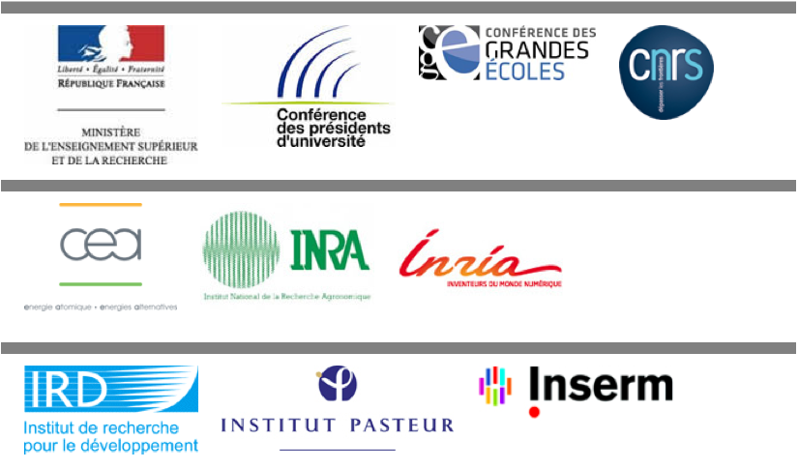
National « Digital Scientific Library » infrastructure, created by the MESR within the National Strategy for Research and Innovation, as a TGIR, made of 10 segments
BSN1: Journal subscriptions and archives BSN6: Archiving, long-term preservation
BSN2: Access and hosting infrastructures BSN7: Scholarly publishing
BSN3: Cataloguing facilities BSN8: Document delivery, resource sharing
BSN4: Open archives BSN9: Professional training
BSN5: Digitisation BSN10: Research data

Slide 10
An even stronger involvement at Inria
4,400
People
(60 % paid by Inria)
8
Research Centers in France
41
International conferences
66
Scientific publications
4,450
180
250
Project teams
Active patents
1,000 Doctoral students
100 Post-Doctoral
300 R&D engineers
3,500
A BUDGET OF
Scientists
€ 265M
Open access policy by Inria set in January 2013
Clear priority to a green open access policy
Mandatory deposit in relation to the annual reporting and assessment
Cautious gold
Refusing the hybrid model (subscription + author-pays)
Strict supervision of native open access
Experimenting new publication models

Slide 11
APC charges - budget

Slide 12
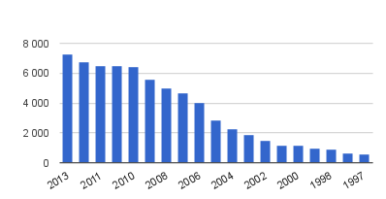
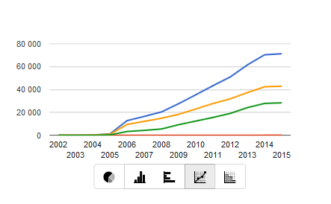
Deposits on the Inria portal
Per year
Cumulated:
Blue: total number of entries
Yellow: full-texts
Green: bibliographical records
61400 entries as of Oct 2014

Slide 13
The Episciences model
Main functions of scholarly journals
(Mabe, 2010)
Implementation in the Episciences model
Registration
HAL: registration with precise affiliation information
Dissemination
HAL: high visibility in search engines
Peer review
Episciences: certificationby editorial committees
Archival record
HAL: long term archiving
Strongly supported by Inria in the context of HAL and the CCSD
Ensure Scientific quality
First Epi-journal active now (January 2014) on top of HAL
Support of the editorial engineering

Slide 14
Riding the wave How Europe can gain from the rising tide of scientific data a vision for 2030
Dealing with research data
Final Report of the High Level Expert Group on Scientific Data delivered 6 Oct 2010

Slide 15
Vision 2030 high-level experts group on Scientific Data
“Our vision is a scientific e-Infrastructure that supports seamless access, use, re-use and trust of data. In a sense, the physical and technical infrastructure becomes invisible and the data themselves become the infrastructure – a valuable asset, on which science, technology, the economy and society can advance.”
High-Level Group on Scientific Data
“Riding the Wave: how Europe can gain from the raising tide of scientific data”

Slide 16
Dealing with research data in the French context
New chapter in BSN on research data
Larger governmental strategy on open data and open government (mission Etalab)
Implication in European e-Infrastructures
E.g. coordination of the DARIAH infrastructure in digital humanities

Slide 17
INRA report on the management and sharing of research data
Published in 2012, the report makes a series of core recommendations for research organisations:
define a scientific data policy and to communicate about it
put together a committee to assess the data produced by the research organisation
take part in international standardisation activities
develop an access portal where all public research data are made available
integrate the scientific data life cycle in the definition of research projects
define guidelines for research data management systems
develop a technical infrastructure for storing research data
identify the needed competences and associated training initiatives
join efforts with other institutions to promote a national policy in the domain of the management and sharing of research data
http://prodinra.inra.fr/?locale=fr#!ConsultNotice:206746

Slide 18
Sally Chambers
DARIAH-EU Coordination Office
DARIAH aims to enhance and support digitally-enabled research and teaching across the humanities and arts…
…a connected network of tools, information, people and methodologies for investigating, exploring and supporting research across the digital arts and humanities…
…for researchers, by researchers…

Slide 19
Open Access as part of a wider scientific information concept
Research organizations need a scientific information strategic plan
Open access to publications and research data is a component thereof
Need for a better coordination of scientific information policies
Shared e-Infrastructures; Joint endeavors to improve the dissemination of research assets
Exploring new models for scientific information
Financing schemes, attribution-based licensing, new modes of scholarly assessment, virtual research environments

Slide 20
Thank you for your attention
Merci pour votre attention

